Slide 1
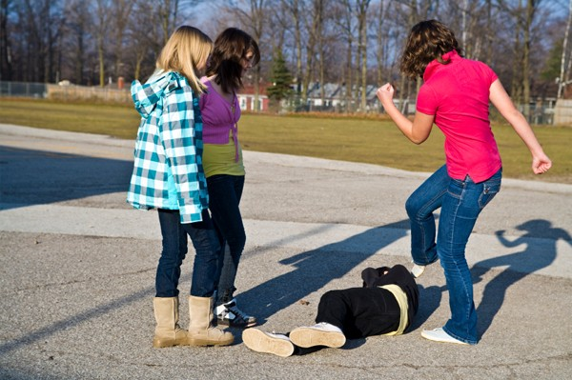
BULLYING DETECTION VIA ACTIVITY RECOGNITION

Slide 2
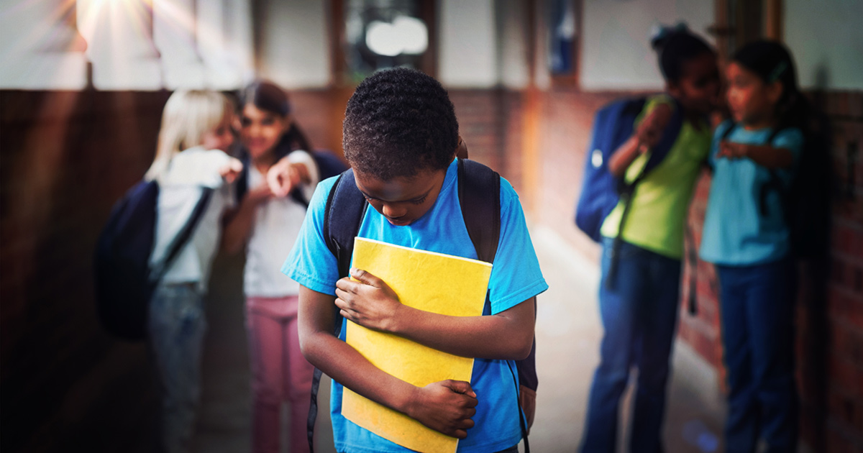
PROBLEM
Physical Bullying is a serious problem at schools causing physical as well as mental harm to students.

Slide 3





The Problem and Affects
Physical and Mental Stress
Performance in Classes
Depression & Lack of Trusts
Lack or No Confidence
Avoid Socializing & Collaboration

Slide 4





A WAY TO FIGHT!
Detection of any Physical Bullying
Notifies Authorities
Reduces Bullying Cases in School Premises
By Implementing AI-based tools, it could start analyze the students behavior via installed cameras real-time and can update the associated authority in case of any bullying/emergency.

Slide 5
BLOCK-DIAGRAM
CAMERAS
Mic Enabled
VIDEO
AUDIO
CLOUD-SERVER
SPLITTED INTO FRAMES
IMAGE CLASSIFICATION
SPEECH TO TEXT
Text Sentiment Analysis
Result fetched via local system
ADMIN
BULLY DETECTION

Slide 6

Thank You

